Slide 1
A NEW METHOD FOR MONAURAL SPEECH SEPARATION USING IDEAL BINARY MASK
Guide: Dr. R. Rajavel, Associate Professor
Project by :
M. Naveen Narayanan - 312214106066
S. Somasundar - 312214106104
DEPARTMENT OF ELECTRONICS AND COMMUNICATION ENGINEERING

Slide 2
OUTLINE
Speech Separation
Objectives of the Project
Literature Survey
Weintraub Speech Separation System
Proposed Speech Separation System
Experimental Results and Discussion
Conclusion
Work plan
Reference

Slide 3
SPEECH SEPARATION
Speech separation is the process of separating the target speech signal from acoustic mixture
The acoustic mixture may be an another speech or environmental noise or both
Speech separation can be used in speech/speaker recognition, voice communication, air-ground communication, hearing aids, etc.
Various methods have been adopted for speech separation, mainly: Spectral Subtraction, Subspace analysis, Hidden Markov Modelling and Computational Auditory Scene Analysis

Slide 4
CASA and IBM
CASA is the study of auditory scene analysis (ASA) by computational means
The Ideal Binary Mask (IBM) has been proposed as a computational goal of CASA
IBM is basically a binary matrix, in which 1 indicates speech dominant T-F units and 0 indicated noise dominant T-F units
IBM is defined as
M(t,f) = 1 if s(t,f) – n(t,f) > 0,
0 Otherwise
where s(t,f) - target speech energy and
n(t,f) - interference energy in a T-F unit

Slide 5
OBJECTIVES OF THE PROJECT
To implement the Weintraub speech separation system and the proposed speech separation system using Matlab
Compare the computational complexity of these systems and show that the proposed system is less complex
Also to show that the proposed system improves speech quality and intelligibility

Slide 6
LITERATURE SURVEY
S.No | TITLE | AUTHORS | YEAR OF PUBLICATION | INFERENCE
1. | A theory and computational model of auditory monaural sound separation | M. Weintraub | 1985 | This research provides a complete analysis of the human auditory system. A conceptual approach was introduced to mimic the knowledge and information used by human auditory system to separate sounds. A computer model was developed to separate the speech of two simultaneous talkers
2. | Frequency analysis and synthesis using a Gammatone filterbank | V. Hohmann | 2002 | This paper describes an efficient implementation of the 4th-order linear Gammatone filter based on an impulse-invariant, all-pole design. A linear auditory filter bank was constructed from these filters. This filter has been used in several applications involving computational auditory peripheral filtering

Slide 7
LITERATURE SURVEY
S.No | TITLE | AUTHORS | YEAR OF PUBLICATION | INFERENCE
3. | A comparison of several computational auditory scene analysis (CASA) techniques for monaural speech segregation | Jihen Zeremdini, Mohamed Anouar Ben Messaoud and Aicha Bouzid | 2015 | This paper mainly focused on the different CASA stages and the IBM for monaural speech segregation. It describes the several methods that used CASA to separate composite speech such as Hu and Wang, Zhang and Liu, Zhao and Shao, Li and Guan approaches etc. Finally an evaluation and a comparison was presented for the different monaural speech segregation methods
4. | Time-Frequency Masks for Monaural Speech Separation: A Comparative Review | Belhedi Wiem, Ben Messaoud Mohamed Anouar, Bouzid Aichl | 2016 | This paper focusses the masking effect on Computational Auditory Scene Analysis (CASA) based systems for single channel speech separation (SCSS). The CASA system employed in this study is Hu and Wang model. The new proposed system uses a soft mask instead of the hard binary mask and they have proved that the soft mask provides a better separation quality.

Slide 8
LITERATURE SURVEY
S.No | TITLE | AUTHORS | YEAR OF PUBLICATION | INFERENCE
5. | Single Channel Speech Enhancement Using Ideal Binary Mask Technique Based on Computational Auditory Scene Analysis | Abrar Hussain, Kalaivani Chellappan, Siti Zamrat | 2016 | In this paper, ideal binary mask which is inspired by the computational auditory analysis is used to analyze and synthesize the input speech signals and masker signals in the time-frequency domain. Synthesized signals are evaluated for speech quality measurement in terms of segmental signal-to-noise ratio. This study uses Malay language based speech as input speech signals

Slide 9
WEINTRAUB SPEECH SEPERATION SYSTEM
Speech separation system proposed by Weintraub [Ref1]
Noisy Speech
Analysis
Filter
Bank
Binary T-F Mask Computation
Synthesis
Filter
Bank
T-F Mask based Noise Suppression
Resynthesized Speech

Slide 10
PROPOSED SPEECH SEPERATION SYSTEM
Proposed system to reduce computational complexity
Noisy Speech
Binary T-F Mask Computation
Resynthesized Speech
Analysis
Filter
Bank
T-F Mask based Noise Suppression
Synthesis
Filter
Bank
For expanded diagram

Slide 11
EXPERIMENTAL RESULTS
Speech and Noise Database: IEEEFemale.wav [IEEE]
Speech: “The drip of the rain made a pleasant sound”
Noise: Speechshapednoise.wav (Noisex-92)
Input SNR = 5dB
Sampling Frequency = 8000Hz
Length of Speech signal = 21982 samples
Number of Channels = 128
Number of Frames per Channel = 274
Number of samples per Frame = 160
Length of Impulse response in Gammatone Analysis and Synthesis Filter Bank = 1024 samples

Slide 12


RESULTS
Speech
Noisy Speech at input SNR 5dB
Resynthesized Speech using Weintraub System
Resynthesized Speech using Modified System

Slide 13
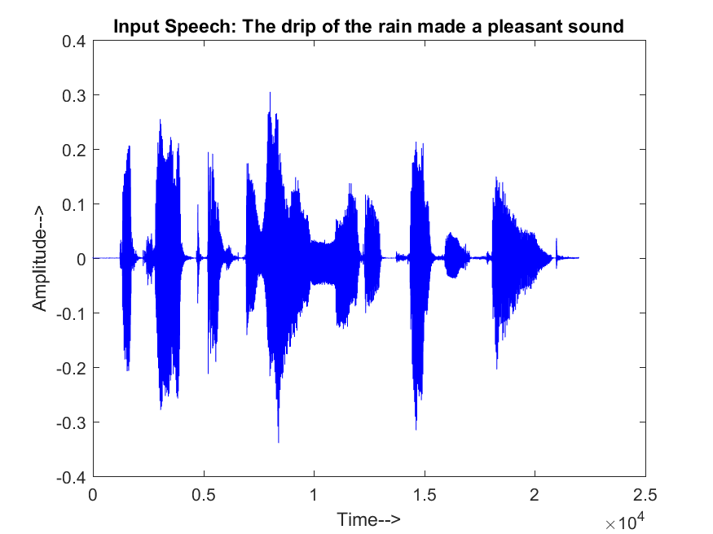
GRAPHICAL RESULTS

Slide 14
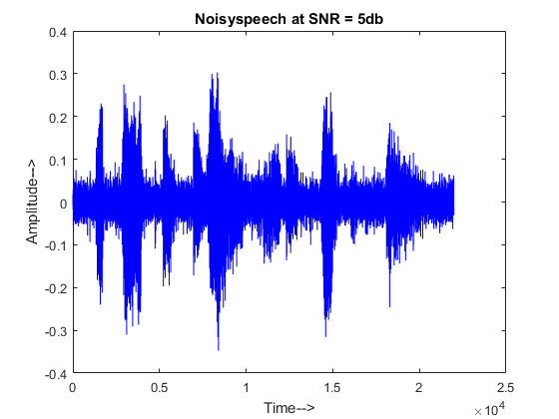
GRAPHICAL RESULTS

Slide 15
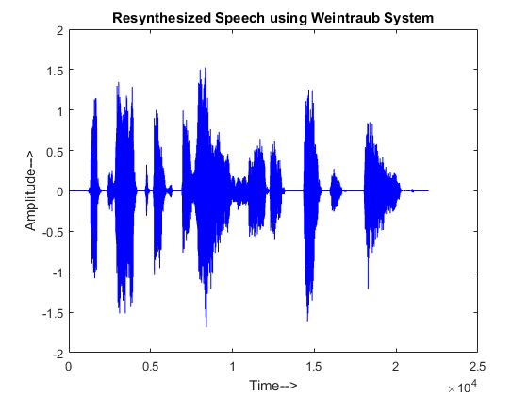
GRAPHICAL RESULTS

Slide 16
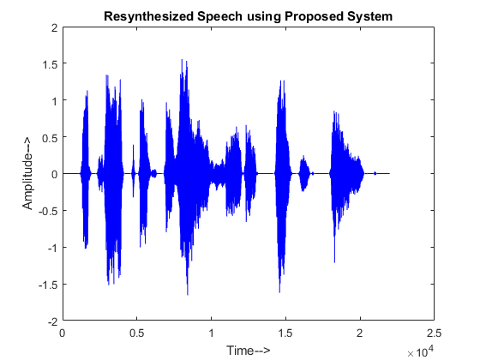
GRAPHICAL RESULTS

Slide 17
PERFORMANCE MEASURE QUALITY (SNR)
INPUT SNR (dB) | OUTPUT SNR (dB) |  | IMPROVEMENT(dB)
 | Weintraub System | Proposed System
-5 | 4.5874 | 4.9005 | 0.3131
0 | 6.6499 | 6.9077 | 0.2578
5 | 9.7100 | 9.9143 | 0.2043
10 | 13.6690 | 13.8812 | 0.2122
15 | 17.6510 | 17.8724 | 0.2214
AVERAGE | 10.45346 | 10.69522 | 0.24176

Slide 18
PERFORMANCE MEASURE QUALITY (SNR)
ANALYSIS FILTER BANK* | SYNTHESIS FILTER BANK* | OUTPUT SNR (dB)
 |  | Weintraub System | Proposed System
1024 | 1024 | 9.6742 | 9.8804
1024 | 512 | 9.6742 | 9.8804
512 | 512 | 9.6742 | 9.8804
512 | 512/128 | 9.6659 | 9.8807
* Number of coefficients in the Gammatone filter bank

Slide 19
PERFORMANCE MEASURE INTELLIGIBILITY (STOI)
INPUT SNR (dB) | OUTPUT STOI |  | IMPROVEMENT
 | Weintraub System | Proposed System
-5 | 0.7109 | 0.7602 | 0.0493
0 | 0.8548 | 0.8595 | 0.0047
5 | 0.8833 | 0.8937 | 0.0104
10 | 0.9171 | 0.9331 | 0.0160
15 | 0.9462 | 0.9504 | 0.0042
AVERAGE | 0.86246 | 0.87938 | 0.01692

Slide 20
COMPARISON OF COMPUATATIONAL COMPLEXITY
ANALYSIS FILTER BANK* | SYNTHESIS FILTER BANK* | COMPUTATION TIME (Secs)
 |  | Weintraub System | Proposed System
1024 | 1024 | 1.6775 | 1.3867 (0.2908)
1024 | 512 | 1.6038 | 1.3429 (0.2609)
512 | 512 | 1.4708 | 1.2992 (0.1716)
512 | 512/128 | 1.3813 | 1.2156 (0.1657)
* Number of coefficients in the Gammatone filter bank

Slide 21
COMPARISON OF COMPUATATIONAL COMPLEXITY
ANALYSIS FILTER BANK* | SYNTHESIS FILTER BANK* | THROUGHPUT (Samples per Sec)
 |  | Weintraub System | Proposed System
1024 | 1024 | 453 | 517 (64)
1024 | 512 | 486 | 524 (38)
512 | 512 | 511 | 548 (37)
512 | 512/128 | 527 | 554 (27)
* Number of coefficients in the Gammatone filter bank

Slide 22
COMPARISON OF COMPUATATIONAL COMPLEXITY
ANALYSIS FILTER BANK* | SYNTHESIS FILTER BANK* | NUMBER OF MULTIPLICATIONS
 |  | Weintraub System | Proposed System
1024 | 1024 | 5768060928 | 5768060928
1024 | 512 | 4327448576 | 4327448576
512 | 512 | 2886836224 | 2886836224
512 | 512/128 | 1924552192 | 1924552192
* Number of coefficients in the Gammatone filter bank

Slide 23
COMPARISON OF COMPUATATIONAL COMPLEXITY
ANALYSIS FILTER BANK* | SYNTHESIS FILTER BANK* | NUMBER OF ADDITIONS
 |  | Weintraub System | Proposed System
1024 | 1024 | 5759635712 | 5759635712
1024 | 512 | 4319023360 | 4319023360
512 | 512 | 2878411008 | 2878411008
512 | 512/128 | 1916126976 | 1916126976
* Number of coefficients in the Gammatone filter bank

Slide 24
CONCLUSION
The Weintraub speech separation system has been implemented using Matlab
The proposed speech separation system has also been implemented using Matlab
Both these systems were tested using standard speech and noise database from IEEE corpus and Noisex-92 respectively.
Mathematical Analysis of the system has been carried out.
Finally the experimental results show that the proposed system improves the speech quality and intelligibility and also reduces the computational delay of the existing monaural speech separation system

Slide 25
WORKPLAN
 | AUG-2017 | SEP-2017 | OCT-2017 | NOV-2017 | DEC-2017 | JAN-2018 | FEB-2018 | MAR-2018
Literature Survey
Implementation of the existing system
Implementation of the proposed system
Comparing the Computational Complexity and Report Preparation

Slide 26
REFERENCES
M. Weintraub, “A theory and computational model of auditory monaural sound separation,” Ph.D. dissertation, Dept. Elect. Eng., Stanford Univ., Stanford, CA, 1985
V. Hohmann, “Frequency analysis and synthesis using a Gammatone filterbank,” Acta Acustica united with Acustica, Vol. 88, pp. 433 – 442, January 2002
D.L. Wang, G.J. Brown, “Fundamentals of Computational Auditory Scene Analysis,” in Computational Auditory Scene Analysis, D.L Wang and G.J Brown, Wiley-IEEE Press, pp. 1-38, 2006
D.L. Wang, “Time–Frequency Masking for Speech Separation and Its Potential for Hearing Aid Design,” Trends in Amplification, Vol. 12, pp.332-353, December 2008

Slide 27
REFERENCES
Ke Hu and DeLiang Wang, “An Unsupervised Approach to Cochannel Speech Separation”, IEEE Transactions on Audio, Speech and Language Processing, Vol.21, No.1, January 2013
N. Harish Kumar, R. Rajavel, “Monaural speech separation system based on optimum soft mask,” IEEE Int. Conf. on Computational Intelligence and Computing Research, 18-20 Dec 2014
Jihen Zeremdini, Mohamed Anouar Ben Messaoud and Aicha Bouzid, “A comparison of several computational auditory scene analysis (CASA) techniques for monaural speech segregation”, Brain Informatics, Vol. 2, Issue 3, pp. 155 – 166, September 2015

Slide 28
REFERENCES
Abrar Hussain, Kalaivani Chellappan and Siti Zamrat, “Single channel speech enhancement using ideal binary mask technique based on computational auditory scene analysis”, Journal of Theoretical and Applied Information Technology, Vol. 91. No. 1, September 2016
Belhedi Wiem, Ben Messaoud Mohamed Anouar, Bouzid Aichl, “Time-Frequency Masks for Monaural Speech Separation: A Comparative Review”, 7th International Conference on Sciences of Electronics, Technologies of Information and Telecommunications (SETIT), 2016

Slide 29
THANK YOU

Slide 30
REFERENCES
V.A. Mane , Prof. Dr. S. B. Patil, ”Survey of Methods and challenges in Computational Auditory sense analysis”, International Journal of Innovative Research in Electrical, Electronics, Instrumentation and Control Engineering, Vol. 4, Issue 9, September 2016

Slide 31
LITERATURE SURVEY
S.No | TITLE | AUTHORS | YEAR OF PUBLICATION | INFERENCE
9. | Survey of Methods and challenges in Computational Auditory sense analysis | V.A. Mane , Prof. Dr. S. B. Patil | 2016 | This paper is a study of various literature and methods that are used to solve the cocktail party problem. This paper discusses about the evolution of computational auditory scene analysis and the various steps taken to design and define the underlying process which will do human mimicry. The paper also describes about the challenges faced by CASA to segregate unvoiced speech from non speech interference

Slide 32
LITERATURE SURVEY
S.No | TITLE | AUTHORS | YEAR OF PUBLICATION | INFERENCE
6. | Time–Frequency Masking for Speech Separation and Its Potential for Hearing Aid Design | D.L. Wang | 2008 | This article introduces the T-F masking concept and reviews T-F masking algorithms that separate target speech from either monaural or binaural mixtures, as well as microphone-array recordings. This article also surveys recent studies that evaluate the perceptual effects of T-F masking techniques, particularly their effectiveness in improving human speech recognition

Slide 33
LITERATURE SURVEY
S.No | TITLE | AUTHORS | YEAR OF PUBLICATION | INFERENCE
7. | An Unsupervised Approach to Cochannel Speech Separation | Ke Hu and DeLiang Wang | 2013 | In this paper, an unsupervised method was proposed for cochannel speech separation. The proposed system uses the CASA algorithm for voiced speech segregation. The proposed system was compared with several other methods across a range of input SNR conditions
8. | Monaural speech separation system based on optimum soft mask | N. Harish Kumar, R. Rajavel | 2015 | This paper proposes the optimum soft mask (OSM) to reduce the musical noise, by replacing the hard limiting weights of IBM with the variable weights. The Signal-to-Noise ratio is used as a measure to evaluate the performance of the proposed soft mask with the existing IBM in the context of monaural speech separation. The rest of the paper is organized in the following manner

Slide 34
COMPUTATIONAL ANALYSIS
Length of Speech signal = 21982 samples
Length of the Impulse response in Gammatone Analysis and Synthesis Filter bank = 1024 samples
Number of Channels = 128
Number of Frames per channel = 275
The number of multiplications in Analysis Filter Bank = Length of Speech signal*Length of Impulse response*Number of Channels = 22004*1024*128 = 2881224704
The number of multiplications in the process of speech separation = Number of Channels*Number of Frames*Length of each Frame = 128*274*160 = 5611520
The number of multiplications in Synthesis Filter Bank = 21982*1024*128 = 2881224704

Slide 35
EXPERIMENTAL RESULTS
 | WEINTRAUB SYSTEM | PROPOSED SYSTEM
Number of Multiplications | 5768060928 | 5768060928
Number of Additions | 5759635712 | 5759635712
Throughput (in samples per secs) | 453 | 517
System Specifications: Intel® Core™ i5-3210M CPU@2.50Ghz
RAM: 4.00GB
64- bit operating System
Windows 10 Home edition
MATLAB Version: R2015a

Slide 36
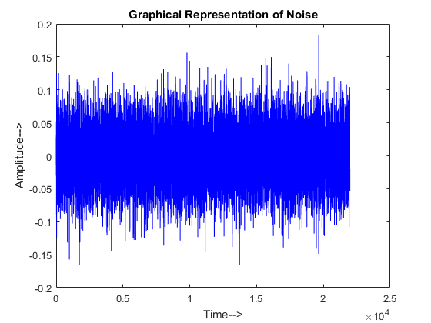
GRAPHICAL RESULTS

